Slide 1

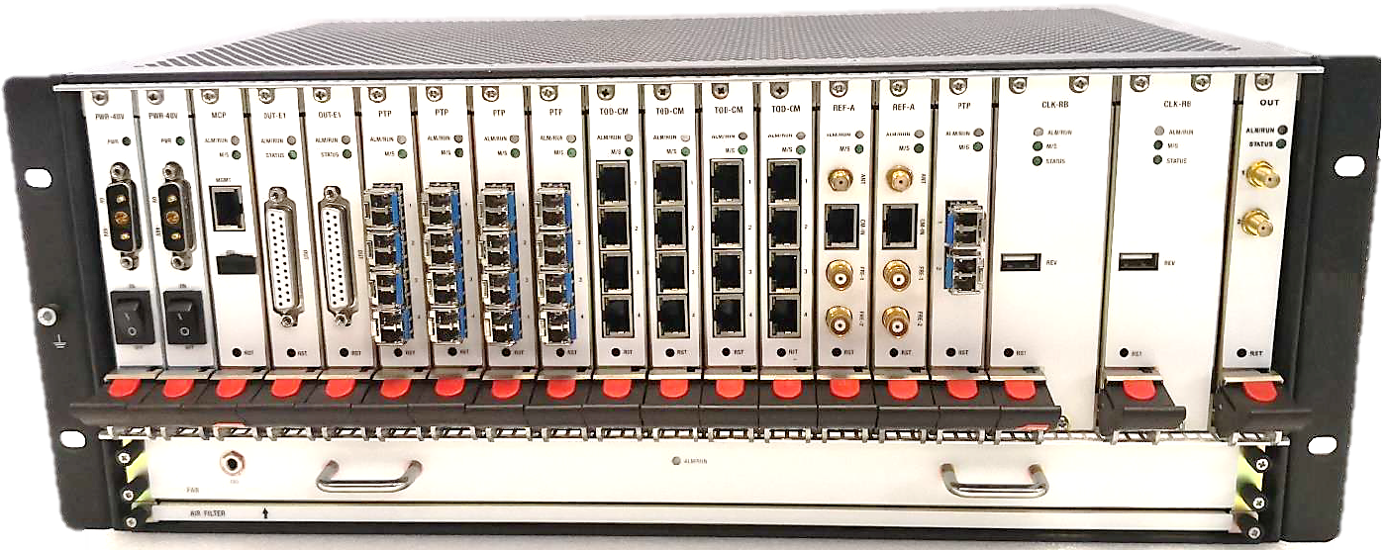
Satellite Common View Device - TFT3001-CV
High Precision Rubidium/OCXO Core Sync Device
Timing is the first requirement of human information interaction since ancient times. Nowadays, information technology and communication technology are constantly updated with each passing day, and the requirements for time-frequency synchronization of various systems are getting higher and higher. For example, today's 5G communication network requires the time source, time transmission, and end device, time synchronization performance to reach 10 to 30ns. In order to cope with the deployment of future networks, our company has specially developed the TFT3001-CV high-precision synchronous products.
TFT3001-CV series high-precision synchronization equipment can be widely used in communication, power, military and other systems, with time frequency tracing, local clock tame, time transmission and time frequency output functions. TFT3001-CV Supports configuration and maintenance-free functions, and provides a network management platform and indicator display. The timing network can be a star, chain and complex models. The equipment output performance meet 5ns accuracy, it can be widely used in telecommunications, electric power and military communication, provide a reliable and high-performance time-frequency synchronization signals.
Suitable in 19 inch rack (4U);
Support 7*24 hours uninterrupted service;
Support Ethernet NMS management;
Support dual -48V DC redundant power;
Support PTP, NTP, SyncE output;
Support Satellite common view;
Support IEEE 1588v2 default profile, ITU-T G.8275.1, ITU-T G.8275.2, ITU-T G.8265.1 profile.
Support PTP/NTP bounding, PTP and NTP output can be configured at the same port;
NTP concurrent output capability 600000 times per second;
IPv4 and IPv6 supported at NTP/PTP

Slide 2
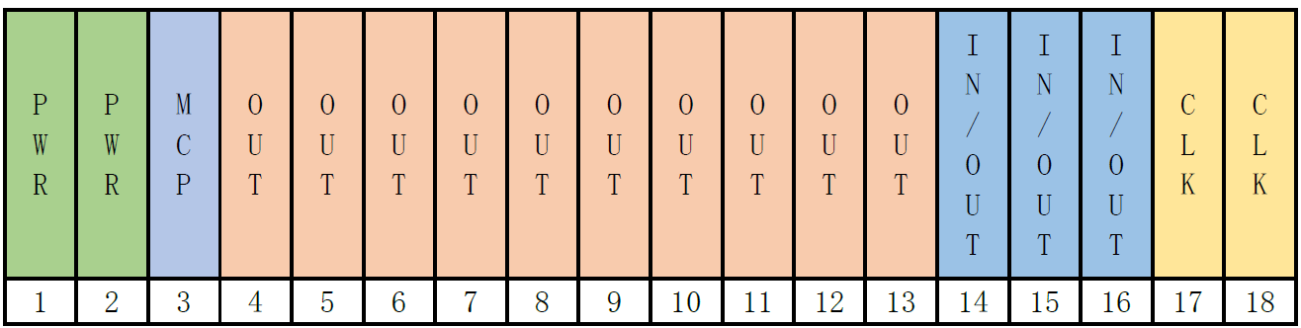
TFT3001-CV Application Case
Synchronization and Time-as-a-Service (TaaS) applications with the high availability
PTP & Sync-E Timing Distribution at the edge of mobile backhaul and fronthaul Telecom networks for frequency and phase synchronization
Synchronization delivery within buildings for indoor small cell radio base stations
Synchronization of legacy network architectures based on NTP and SSU
Time as a service (TaaS) into data center, financial, health and media networks
Railway transit network synchronization
Broadcast system, intelligent hospitals, financial system, civil aviation system, smart city synchronization
Smart Power Grid synchronization
GNSS
PTP
1PPS + TOD
10MHz
BITS
2MHz / 2Mbps
PTP
PPS + TOD
NTP
B-AC / B-DC
TFT3001-CV Slot Layout

Slide 3





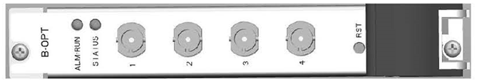

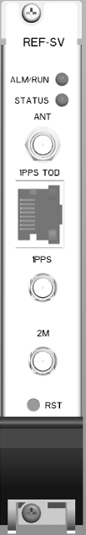
TFT3001-CV Cards / Modules
 | PTP Module | In/Output configurable. 4x SFP ports 5W (norm working condition) 232(L) * 100(W) * 20(H) mm
 | NTP Module | Output module. 4x SFP ports 5W (norm working condition) 232(L) * 100(W) * 20(H) mm
 | 1PPS + TOD | Output module. 4x RJ45 RS422 ports 5W (norm working condition) 232(L) * 100(W) * 20(H) mm
 | E1 Module | Output module. DB25 port (32x outputs) 5W (norm working condition) 232(L) * 100(W) * 20(H) mm
 | B-DC Electrical | Output module. 4x BNC @TTL 5W (norm working condition) 232(L) * 100(W) * 20(H) mm
 | B-OPT Optical | Output module. 4x ST-Optical 5W (norm working condition) 232(L) * 100(W) * 20(H) mm
 | B-AC | Output module. 4x BNC 5W (norm working condition) 232(L) * 100(W) * 20(H) mm
 | REF-CV | Common view module. 1*GNSS, 1*1PPS+TOD, 1*1PPS, 1*2M; 5W (norm working condition) 232(L) * 100(W) * 20(H) mm
TFT3001-CV Holdover performance
If external source is not available, TFT3001-CV will use embedded OCXO or Rubidium clock as working clock. OCXO or Rubidium option clock performance show as below:
Item | OCXO | Rubidium
Frequency stability | ±3E-10 per day | ±5E-12 per day
Temperature stability | ±1.5E-10 @-40℃~75℃ | ±6E-10 @-20℃~50℃
Phase holdover | 30us per day | 500ns per day
Aging(30 days after powered on) | ±3E-10 per day | ±5E-12 per day
 | ±5E-9 per month | ±5E-11 per month

Slide 4
TFT3001-CV key feature
Suitable in 19 inch rack(4U);
Support 7*24 hours uninterrupted service;
Support Ethernet NMS management;
Support dual -48V DC redundant power;
Support PTP, NTP, SyncE output
Support IEEE 1588v2 default profile, ITU-T G.8275.1 profile.
Support PTP/NTP bounding, PTP and NTP output can be configured at the same port;
NTP concurrent output capability 600000 times per second;
IPv4 and IPv6 supported at NTP/PTP port；
TFT3001-CV In/Out interface
1~3*GNSS(GPS/BDS/GLONASS/GALILEO) input;
1~8*2MHz/2Mbps input;
1~3*1PPS+TOD input;
1~3*10MHz input;
4~48*PTP/NTP output;
4~48*IRIG-B output;
4~48*1PPS+TOD output;
32~384*2MHz/2Mbps output;
Phase & Frequency Accuracy
10MHz Frequency Performance: better than 1E-13/day when locked to GNSS
1PPS Phase Performance: better than ±5ns when locked to GNSS
Supported Network Protocol
IEEE1588v2(PTP)
ITU-T G.8264, G.8273.2.
ITU-T G.8275.1, G.8275.2, G.8265.1
RFC 1059 (NTPv1), RFC 1119 (NTPv2), RFC 1305 (NTPv3), RFC 5905 (NTPv4)
ARP
IPv4/IPv6
FTP
Telnet/SSH
SNMP
Management Port
CLI local management via serial port (USB)
Telnet configure or monitor device
HTTP based visible management
SNMP based centralized management
Environment
Dimension: 435.8mm x 176.7mm x 305mm (WxHxD)
Operation temperature (ambient): -5 to +60ºC
Storage temperature: -40 to +70ºC
Humidity: 0 to 95% (non-condensation)
Dual DC PSU: -48VDC (Tolerant -36 ~ -72VDC).

